Slide 1
CHAPTER – 03 BOOLEAN ALGEBRA
XI
Computer Science (083)
Board : CBSE
Unit 1
Computer Systems and Organisation (CSO)

Slide 2
INTRODUCTION

Slide 3
INTRODUCTION
Developed by English Mathematician George Boole in between 1815 - 1864.
It is described as an algebra of logic or an algebra of two values i.e True or False.
The term logic means a statement having binary decisions i.e True/Yes or False/No.

Slide 4
APPLICATION OF BOOLEAN ALGEBRA

Slide 5
APPLICATION OF BOOLEAN ALGEBRA
It is used to perform the logical operations in digital computer.
In digital computer True represent by ‘1’ (high volt) and False represent by ‘0’ (low volt)
Logical operations are performed by logical operators. The fundamental logical operators are:
1. AND (conjunction)
2. OR (disjunction)
3. NOT (negation/complement)

Slide 6
AND operator
It performs logical multiplication and denoted by (.) dot.
X Y X.Y
0 0 0
0 1 0
1 0 0
1 1 1

Slide 7
OR operator
It performs logical addition and denoted by (+) plus.
X Y X+Y
0 0 0
0 1 1
1 0 1
1 1 1

Slide 8
NOT operator
It performs logical negation and denoted by (-) bar. It operates on single variable.
X X (means complement of x)
0 1
1 0

Slide 9
Truth Table
Truth table is a table that contains all possible values of logical variables/statements in a Boolean expression.
No. of possible combination =
2^{n}, where n=number of variables used in a Boolean expression.

Slide 10
Truth Table
The truth table for XY + Z is as follows:
Dec X Y Z XY XY+Z
0 0 0 0 0 0
1 0 0 1 0 1
2 0 1 0 0 0
3 0 1 1 0 1
4 1 0 0 0 0
5 1 0 1 0 1
6 1 1 0 1 1
7 1 1 1 1 1

Slide 11
Tautology & Fallacy
If the output of Boolean expression is always True or 1 is called Tautology.
If the output of Boolean expression is always False or 0 is called Fallacy.

Slide 12
Tautology & Fallacy

Slide 13
Exercise
1. Evaluate the following Boolean expression using Truth Table.
(a) X’Y’+X’Y (b) X’YZ’+XY’
(c) XY’(Z+YZ’)+Z’
2. Verify that P+(PQ)’ is a Tautology.
3. Verify that (X+Y)’=X’Y’

Slide 14
Implementation
Boolean Algebra applied in computers electronic circuits. These circuits perform Boolean operations and these are called logic circuits or logic gates.

Slide 15
Logic Gate

Slide 16
Logic Gate
A gate is an digital circuit which operates on one or more signals and produce single output.
Gates are digital circuits because the input and output signals are denoted by either 1(high voltage) or 0(low voltage).
There are three basic gates and are:
1. AND gate
2. OR gate
3. NOT gate

Slide 17
AND gate

Slide 18
AND gate
The AND gate is an electronic circuit that gives a high output (1) only if all its inputs are high.
AND gate takes two or more input signals and produce only one output signal.
Input A | Input B | Output AB
0 | 0 | 0
0 | 1 | 0
1 | 0 | 0
1 | 1 | 1

Slide 19
OR gate

Slide 20
OR gate
The OR gate is an electronic circuit that gives a high output (1) if one or more of its inputs are high.
OR gate also takes two or more input signals and produce only one output signal.
Input A | Input B | Output A+B
0 | 0 | 0
0 | 1 | 1
1 | 0 | 1
1 | 1 | 1

Slide 21
NOT gate

Slide 22
NOT gate
The NOT gate is an electronic circuit that gives a high output (1) if its input is low .
NOT gate takes only one input signal and produce only one output signal.
The output of NOT gate is complement of its input.
It is also called inverter.
Input A | Output A
0 | 1
1 | 0

Slide 23
PRACTICAL APPLICATIONS OF LOGIC GATES

Slide 24
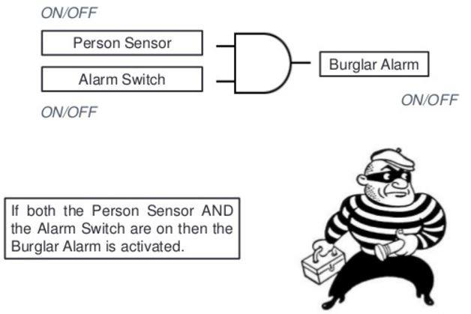
PRACTICAL APPLICATIONS OF LOGIC GATES
AND Gate
So while going out of the house you set the "Alarm Switch" and if the burglar enters he will set the "Person switch", and tada the alarm will ring.

Slide 25
PRACTICAL APPLICATIONS OF LOGIC GATES
AND Gate
Electronic door will only open if it detects a person and the switch is set to unlocked.
Microwave will only start if the start button is pressed and the door close switch is closed.

Slide 26
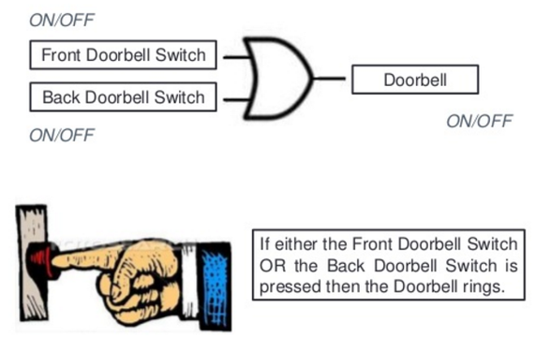
PRACTICAL APPLICATIONS OF LOGIC GATES
OR Gate
You would of course want your doorbell to ring when someone presses either the front door switch or the back door switch..(nice)

Slide 27
PRACTICAL APPLICATIONS OF LOGIC GATES
NOT Gate
When the temperature falls below 20c the Not gate will set on the central heating system (cool huh).

Slide 28
NAND, NOR XOR, XNOR GATES

Slide 29
NAND Gate
Known as a “universal” gate because ANY digital circuit can be implemented with NAND gates alone.

Slide 30
NAND Gate
NAND
X Y Z
0 0 1
0 1 1
1 0 1
1 1 0
X
Z
Y
Z = ~(X & Y)
nand(Z,X,Y)

Slide 31
NAND Gate
X
F = (X•X)’
= X’+X’
= X’
X
F = X’
X
X
F X•Y
F = ((X•Y)’)’
= (X’+Y’)’
= X’’•Y’’
= X•Y
Y
Y
X
X
F = (X’•Y’)’
= X’’+Y’’
= X+Y
F = X+Y
Y
Y

Slide 32
NOR Gate

Slide 33
NOR Gate
NOR
X Y Z
0 0 1
0 1 0
1 0 0
1 1 0
X
Z
Y
Z = ~(X | Y)
nor(Z,X,Y)

Slide 34
Exclusive-OR Gate

Slide 35
Exclusive-OR Gate
XOR
X Y Z
X
Z
0 0 0
Y
0 1 1
Z = X ^ Y
xor(Z,X,Y)
1 0 1
1 1 0

Slide 36
Exclusive-NOR Gate

Slide 37
Exclusive-NOR Gate
XNOR
X Y Z
X
Z
0 0 1
Y
0 1 0
Z = ~(X ^ Y)
Z = X ~^ Y
xnor(Z,X,Y)
1 0 0
1 1 1

Slide 38
POWER CONSUMPTION OF SYSTEM

Slide 39
Basic Theorem of Boolean Algebra
T1 : Properties of 0
(a) 0 + A = A (b) 0 A = 0
T2 : Properties of 1
(a) 1 + A = 1 (b) 1 A = A

Slide 40
Basic Theorem of Boolean Algebra
T3 : Commutative Law
(a) A + B = B + A (b) A B = B A
T4 : Associate Law
(a) (A + B) + C = A + (B + C) (b) (A B) C = A (B C)
T5 : Distributive Law
(a) A (B + C) = A B + A C (b) A + (B C) = (A + B) (A + C)
(c) A+A’B = A+B

Slide 41
Basic Theorem of Boolean Algebra
T6 : Indempotence (Identity ) Law
(a) A + A = A (b) A A = A
T7 : Absorption (Redundance) Law
(a) A + A B = A (b) A (A + B) = A

Slide 42
Basic Theorem of Boolean Algebra
T8 : Complementary Law
(a) X+X’=1
(b) X.X’=0
T9 : Involution
(a) x’’ = x
T10 : De Morgan's Theorem
(a) (X+Y)’=X’.Y’
(b) (X.Y)’=X’+Y’

Slide 43
De Morgan's Theorem

Slide 44
De Morgan's Theorem 1
Theorem 1 A . B = A + B

Slide 45
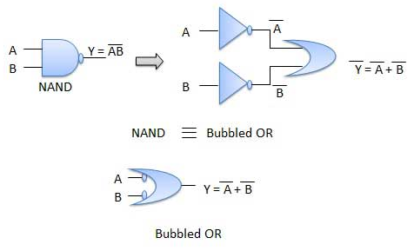
De Morgan's Theorem 1
Theorem 1 A . B = A + B

Slide 46
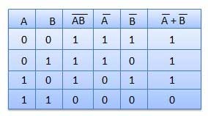
De Morgan's Theorem 1
Theorem 1 A . B = A + B

Slide 47
De Morgan's Theorem 2
Theorem 1 A + B = A . B

Slide 48
De Morgan's Theorem 2
Theorem 2 A + B = A . B

Slide 49
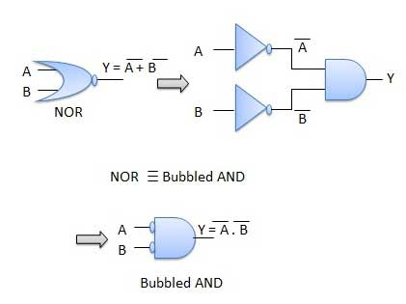
De Morgan's Theorem 2
Theorem 2 A + B = A . B

Slide 50
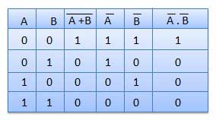
De Morgan's Theorem 2
Theorem 2 A + B = A . B

Slide 51
CLASS TEST

Slide 52
Thank You

